Slide 1
Truman State University Teaching Lecture
The Glycolysis Metabolic Pathway and Biochemistry
Erich R. Kuechler
Student Lecture Seminar
E-mail
Office Hours
Lecture Slides can be found @ https://github.com/ekuechler/2022_truman
Graphics information goes here
Citations will go here

Slide 2
Learning Objectives:
Today We Will Learn How to:
Summarize the key steps in the glycolysis metabolic pathway
Recall the structural features, function, and general biochemical reaction of kinases
Recognize enzymes associated to this pathway
Articulate the mechanism of action of several enzymes in the glycolysis metabolic pathway

Slide 3
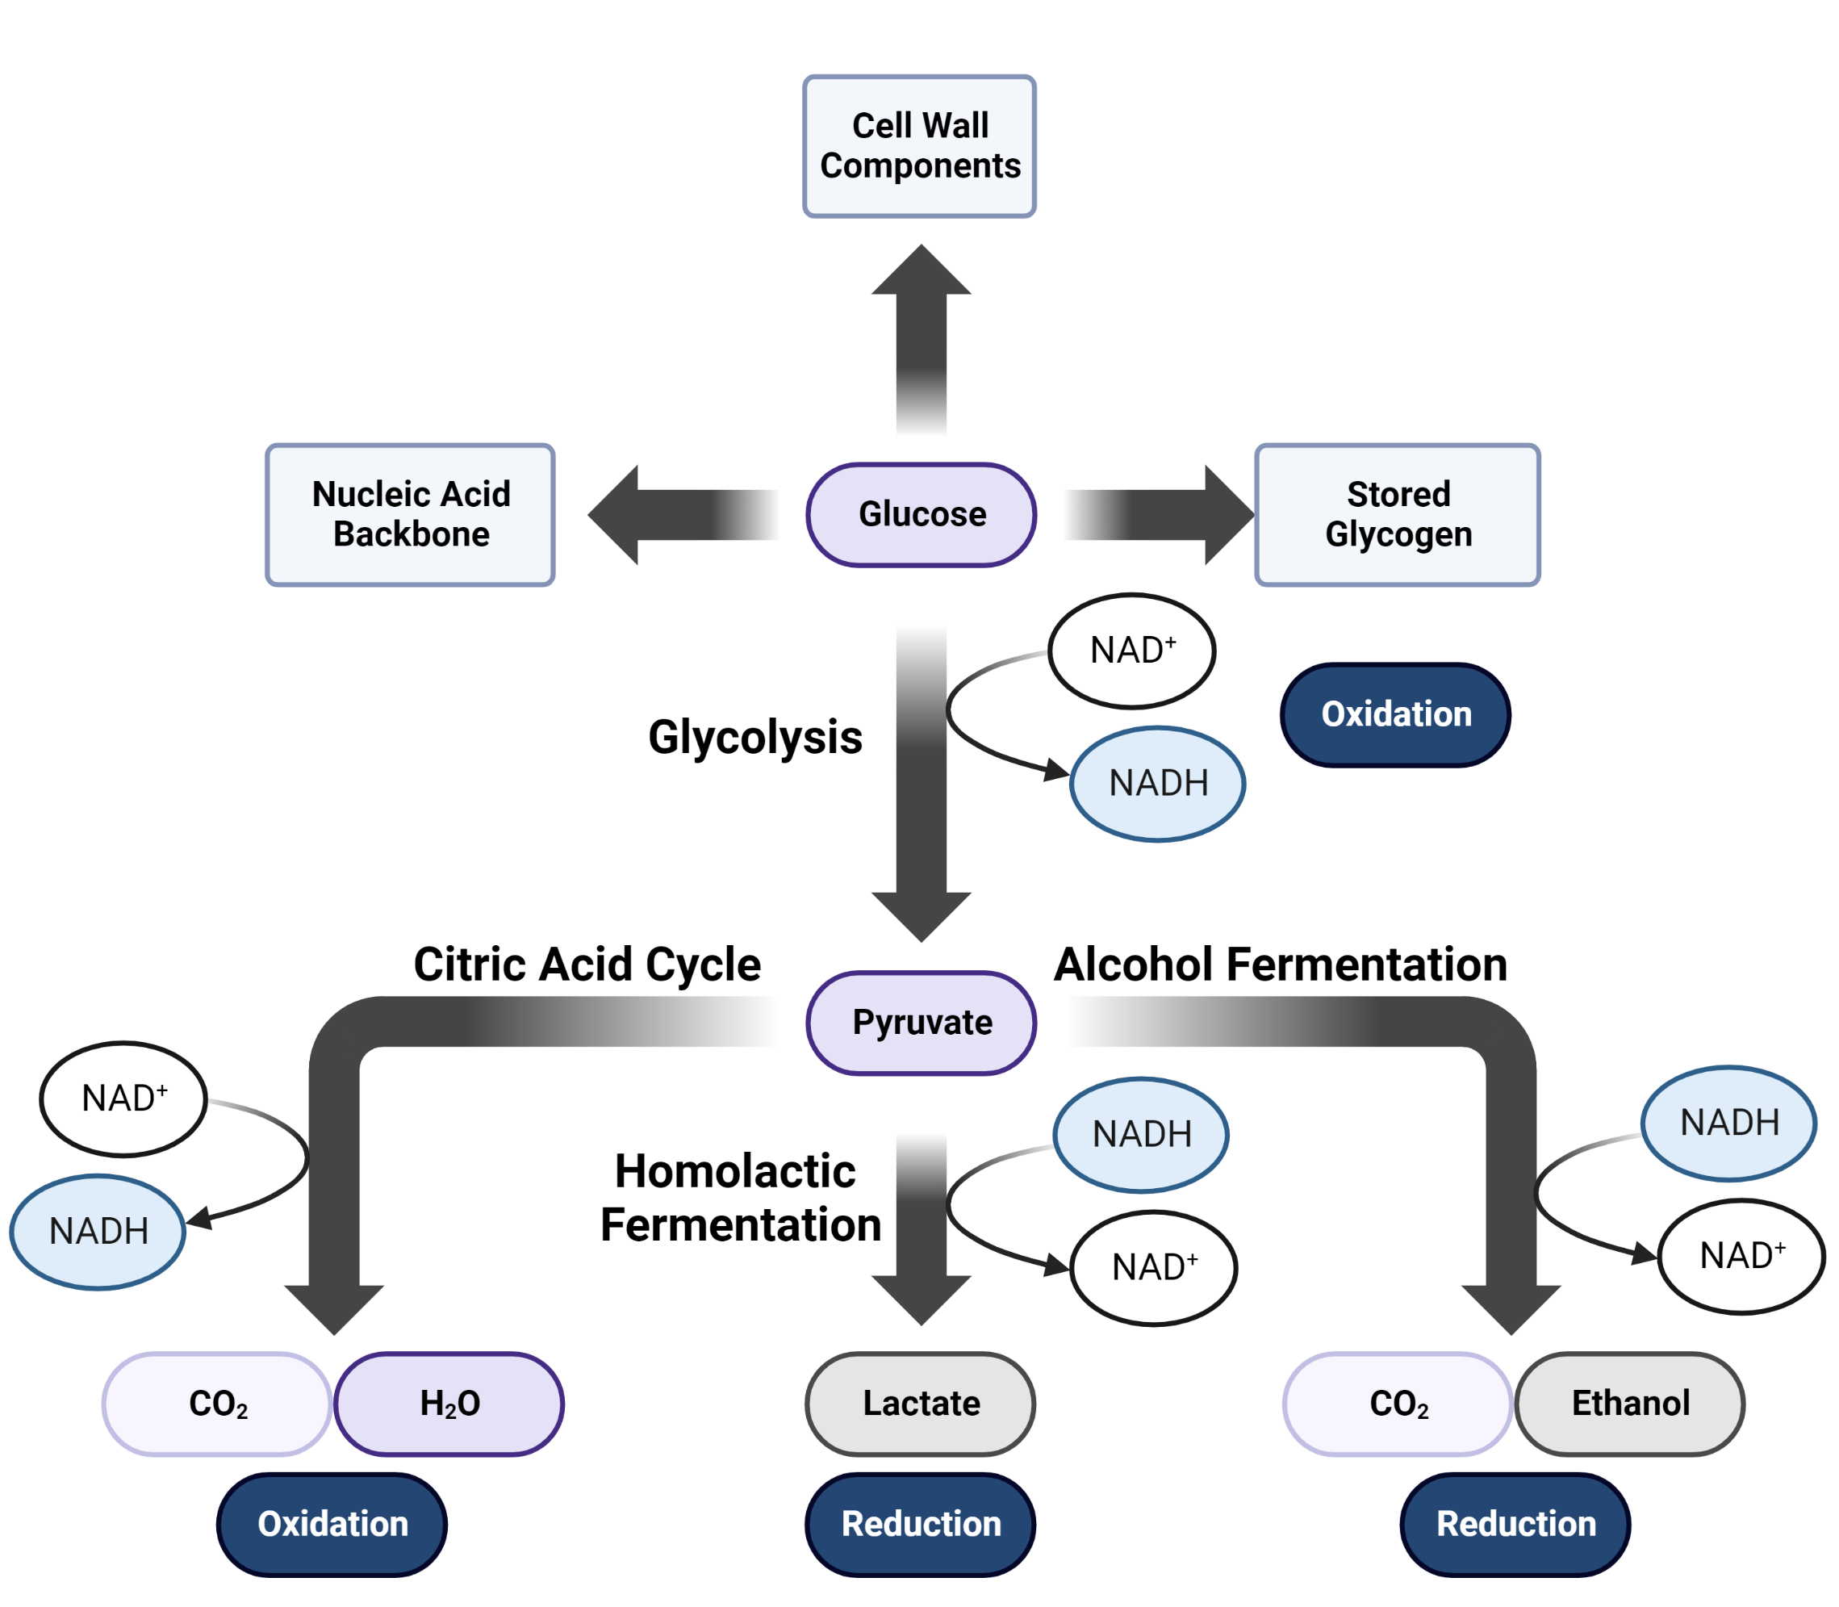
Glucose in the Body
Image made in BioRender
Lehninger Principles in Biochemistry – 4th Edition (2005)
Notes:
complete oxidation of glucose to carbon dioxide and water proceeds with a standard free-energy change of 2,840 kJ/mol. Glucose is not only an excellent fuel, it is also a remarkably versatile precursor, capable of supplying a huge array of metabolic intermediates for biosynthetic reactions.

Slide 4
Glucose in the Body
Image made in BioRender
Lehninger Principles in Biochemistry – 4th Edition (2005)
Notes:
complete oxidation of glucose to carbon dioxide and water proceeds with a standard free-energy change of 2,840 kJ/mol. Glucose is not only an excellent fuel, it is also a remarkably versatile precursor, capable of supplying a huge array of metabolic intermediates for biosynthetic reactions.

Slide 5
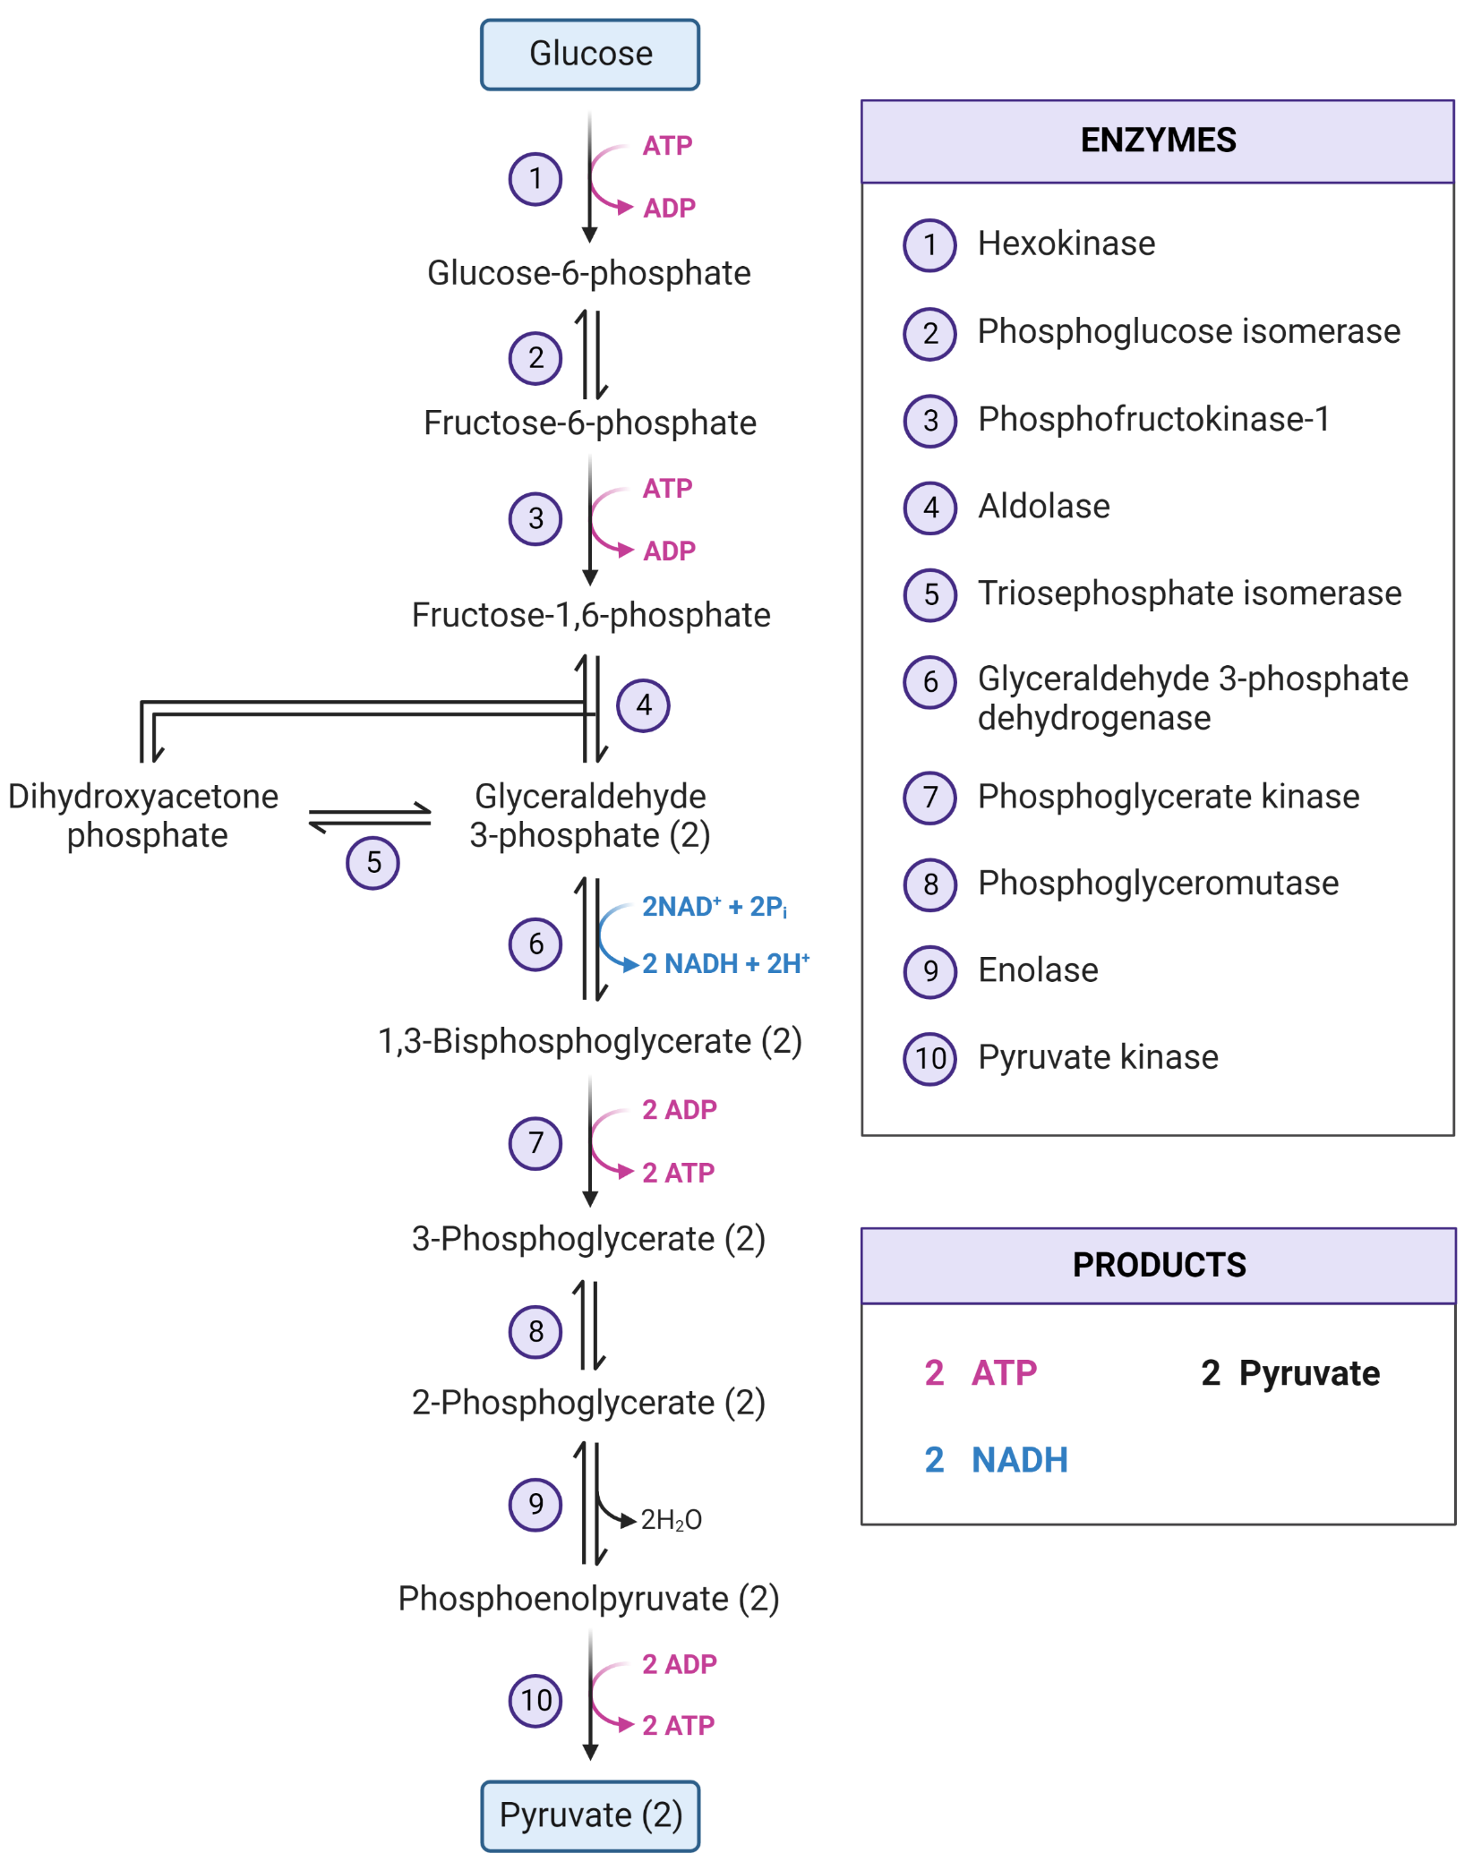
Glucose Metabolism: Overview
Nearly universal.
Conserves energy as ATP (adenosine triphosphate) and NADH (nicotinamide adenine dinucleotide)
All ten steps involve phosphorylated compounds of six or three carbons.
Is highly regulated.
Image made in BioRender
Lehninger Principles in Biochemistry – 4th Edition (2005)
Notes:
Glycolysis is a near-universal pathway by which a glucose molecule is oxidized to two molecules of pyruvate, with energy conserved as ATP and NADH. ■ All ten glycolytic enzymes are in the cytosol, and all ten intermediates are phosphorylated compounds of three or six carbons. ■ In the preparatory phase of glycolysis, ATP is invested to convert glucose to fructose 1,6-bisphosphate. The bond between C-3 and C-4 is then broken to yield two molecules of triose phosphate. ■ In the payoff phase, each of the two molecules of glyceraldehyde 3-phosphate derived from glucose undergoes oxidation at C-1; the energy of this oxidation reaction is conserved in the formation of one NADH and two ATP per triose phosphate oxidized. The net equation for the overall process is
Glycolysis is tightly regulated in coordination with other energy-yielding pathways to assure a steady supply of ATP. Hexokinase, PFK-1, and pyruvate kinase are all subject to allosteric regulation that controls the flow of carbon through the pathway and maintains constant levels of metabolic intermediates

Slide 6
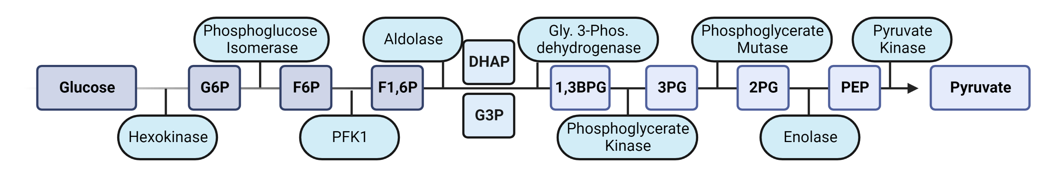
Glycolysis: Setup and Payoff
Image made in BioRender
Lehninger Principles in Biochemistry – 4th Edition (2005)

Slide 7
Glycolysis: Setup and Payoff
Preparatory Phase of Glycolysis
Payoff Phase of Glycolysis
Image made in BioRender
Lehninger Principles in Biochemistry – 4th Edition (2005)
Notes:
Glucose + 2NAD+ + 2ADP + 2Pi -> 2 pyruvate + 2NADH + 2H+ + 2ATP + 2H2O

Slide 8
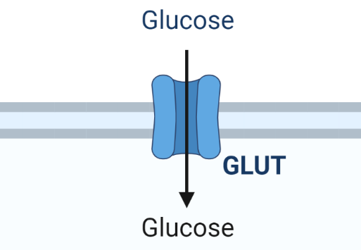
Glucose Cellular Import:
Transporter | Tissues Expressed | Notes
GLUT1 | All, Red Blood Cells | Basal uptake of glucose
GLUT2 | Liver, Pancreas, Intestine | Highest K_{M}
GLUT3 | Brain | High affinity basal uptake
GLUT4 | Muscle, Fat, Heart | Insulin regulated
Image made in BioRender
Lehninger Principles in Biochemistry – 4th Edition (2005)

Slide 9
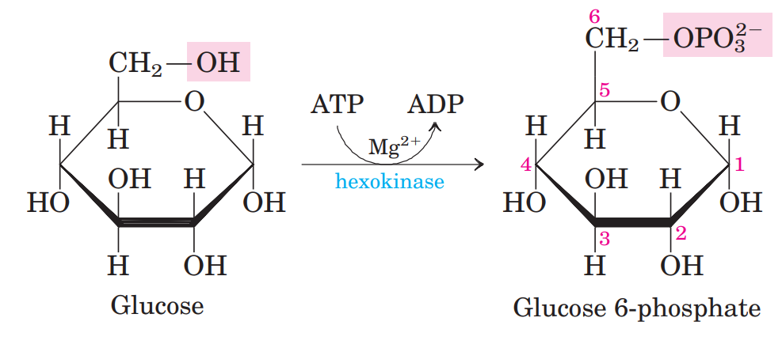
Reaction One: Hexokinase, the First Investment
Chapter 14 page 526
Lehninger Principles in Biochemistry – 4th Edition (2005)

Slide 10
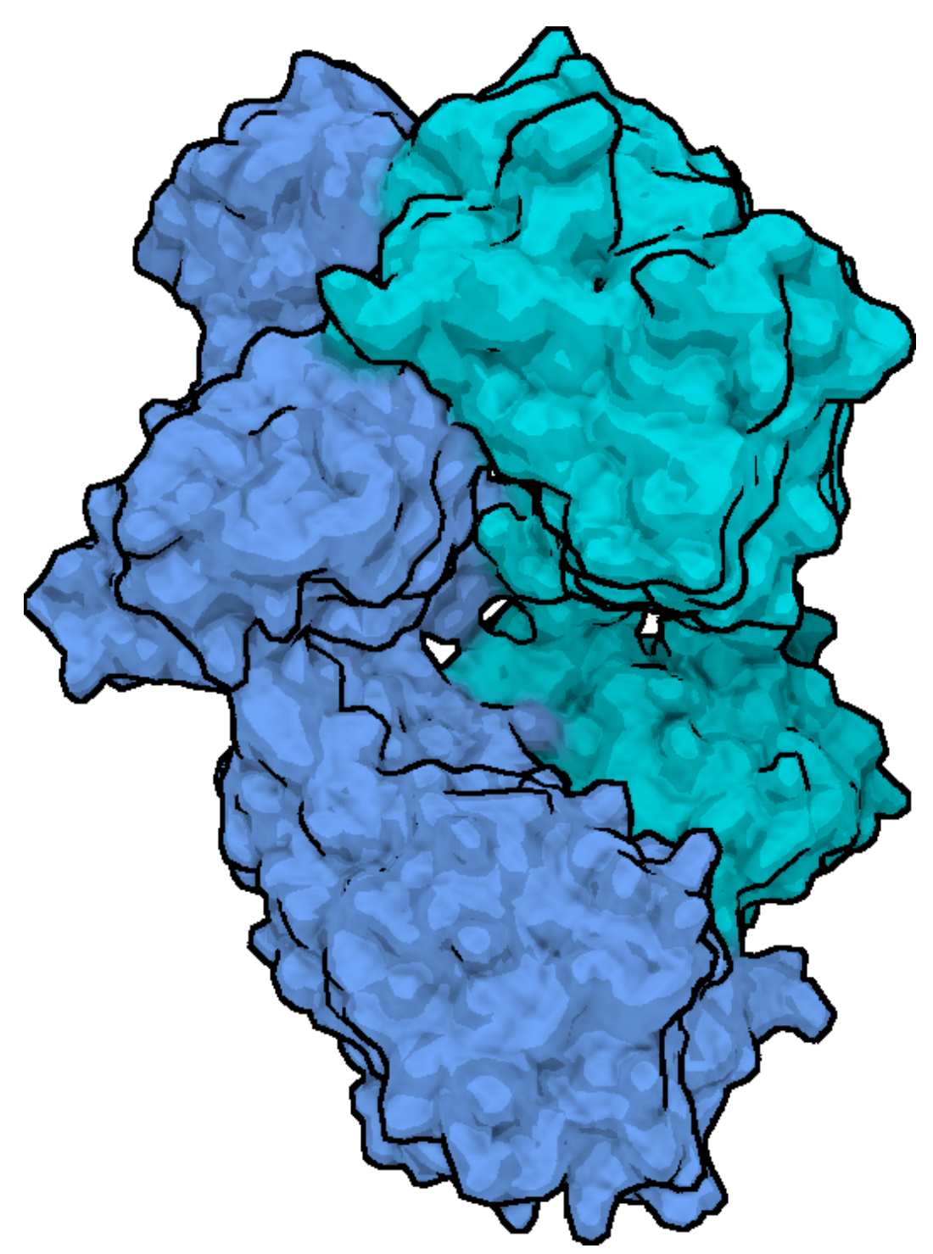
Kinase Catalytic Domains: Hexokinase
Like the other nine enzymes of glycolysis, hexokinase is a soluble, cytosolic protein.
Required Mg²⁺ for activity.
Undergoes a profound change in shape, an induced fit, when it binds glucose.
The two domains of the protein move around 8Å closer during ATP binding
This movement aligns ATP closer to bound glucose and blocks solvent access to the active site, which could hydrolyze) the activated bonds of ATP
Image made in BioRender
Röhm et al. Topics in Medicinal Chemistry Volume 36. Function, Structure and Topology of Protein Kinases. 2020
Notes:
Hexokinase, like many other kinases, requires Mg2 for its activity, because the true substrate of the enzyme is not ATP4 but the MgATP2 complex (see Fig. 13–2). Mg2 shields the negative charges of the phosphoryl groups in ATP, making the terminal phosphorus atom an easier target for nucleophilic attack by an OOH of glucose. Hexokinase undergoes a profound change in shape, an induced fit, when it binds glucose; two domains of the protein move about 8 Å closer to each other when ATP binds (see Fig. 6–22). This movement brings bound ATP closer to a molecule of glucose also bound to the enzyme and blocks the access of water (from the solvent), which might otherwise enter the active site and attack (hydrolyze) the phosphoanhydride bonds of ATP. Like the other nine enzymes of glycolysis, hexokinase is a soluble, cytosolic protein.

Slide 11
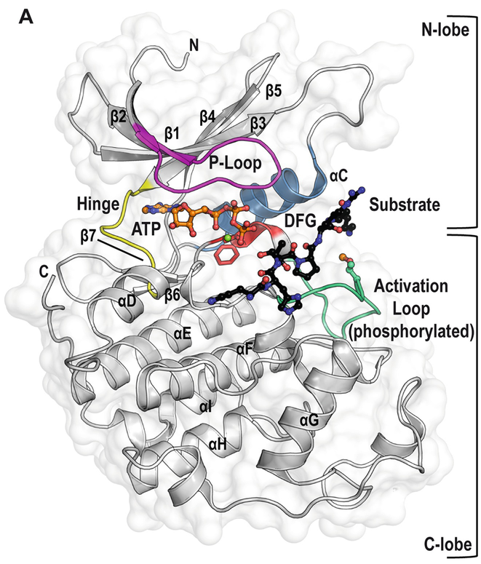
Kinase Catalytic Domains: Molecular Detail
ATP forms hydrogen bonds with hinge region
P-Loop region has a GXGXφG motif which coordinates the ATP phosphates
The β3-sheet contains a conserved VIAK motif that forms a salt bridge with ATP phosphate groups and the αC helix.
A DFG (Asp-Phe-Gly) motif marks the beginning of the activation loop. The conserved Asp interacts with Mg²⁺ itself coordinating to the ATP phosphates
Röhm et al. Topics in Medicinal Chemistry Volume 36. Function, Structure and Topology of Protein Kinases. 2020

Slide 12
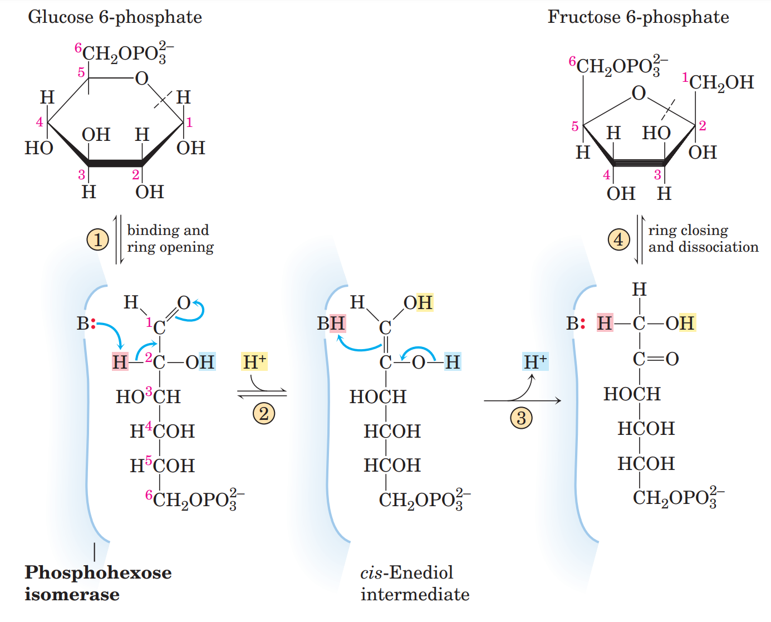
Reaction Two: Glucose Isomerization to Fructose
Chapter 14 page 526
Lehninger Principles in Biochemistry – 4th Edition (2005)

Slide 13
Reaction Two: Mechanism
Lehninger Principles in Biochemistry – 4th Edition (2005)
Notes:
Glu acting as a Lewis Base acting on the nearby carbonyl group

Slide 14
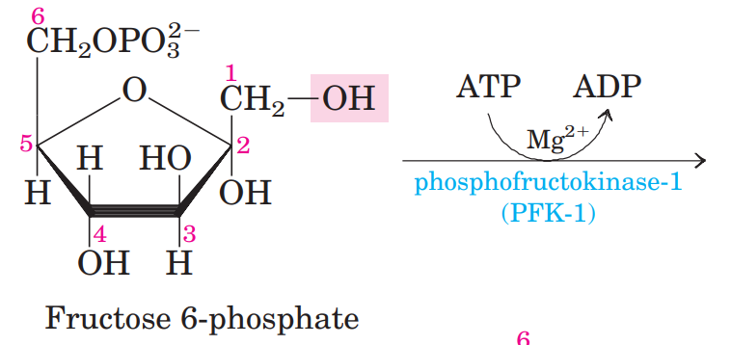
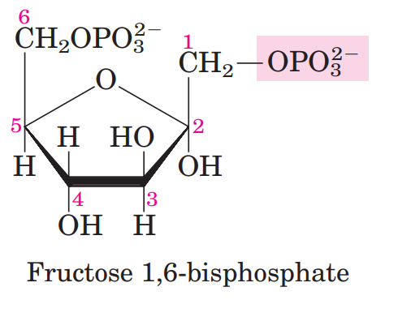
Reaction Three: PFK-1, the Second Investment
Chapter 14 page 526
Lehninger Principles in Biochemistry – 4th Edition (2005)
Notes:
The PFK-1 reaction is essentially irreversible under cellular conditions, and it is the first “committed” step in the glycolytic pathway; glucose 6-phosphate and fructose 6-phosphate have other possible fates, but fructose 1,6-bisphosphate is targeted for glycolysis.

Slide 15
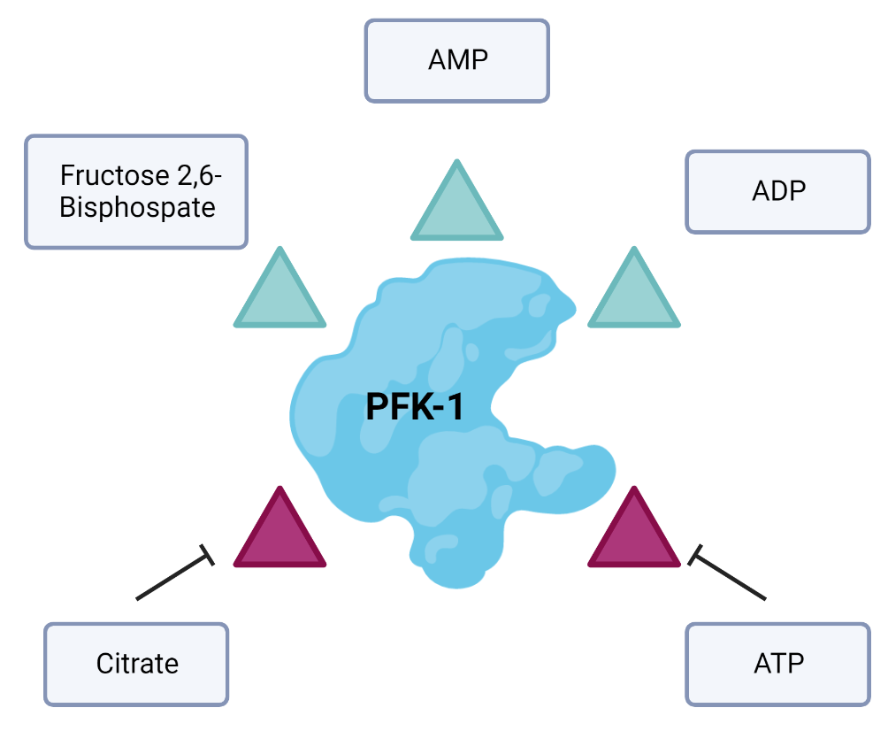
PFK-1 Regulation
Image made in BioRender
Lehninger Principles in Biochemistry – 4th Edition (2005)
Notes:
The PFK-1 reaction is essentially irreversible under cellular conditions, and it is the first “committed” step in the glycolytic pathway; glucose 6-phosphate and fructose 6-phosphate have other possible fates, but fructose 1,6-bisphosphate is targeted for glycolysis.

Slide 16
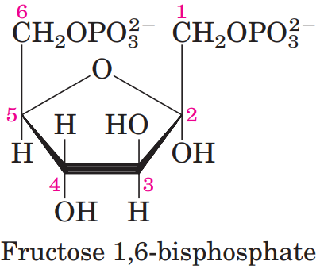
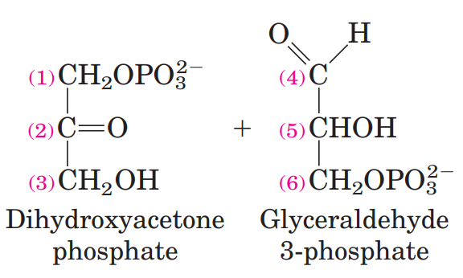
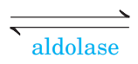
Reaction Four: The ‘Lysis’ of Glycolysis
Chapter 14 page 527
Lehninger Principles in Biochemistry – 4th Edition (2005)

Slide 17
Reaction Four: The ‘Lysis’ of Glycolysis
Chapter 14 page 527
Lehninger Principles in Biochemistry – 4th Edition (2005)

Slide 18
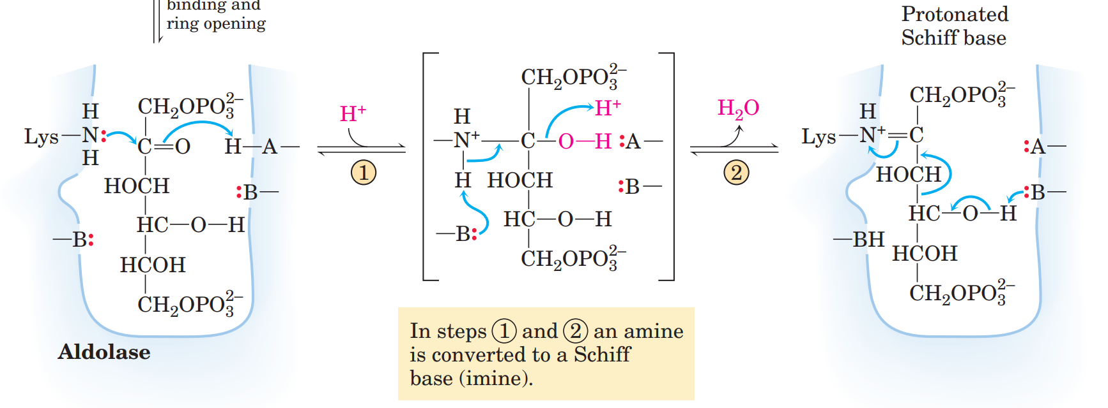
Reaction Four: The Mechanism
Glu
Lys
Arg
Chapter 14 page 528
Lehninger Principles in Biochemistry – 4th Edition (2005)
Notes:
The carbonyl reacts with an active-site Lys residue to form an imine,

Slide 19
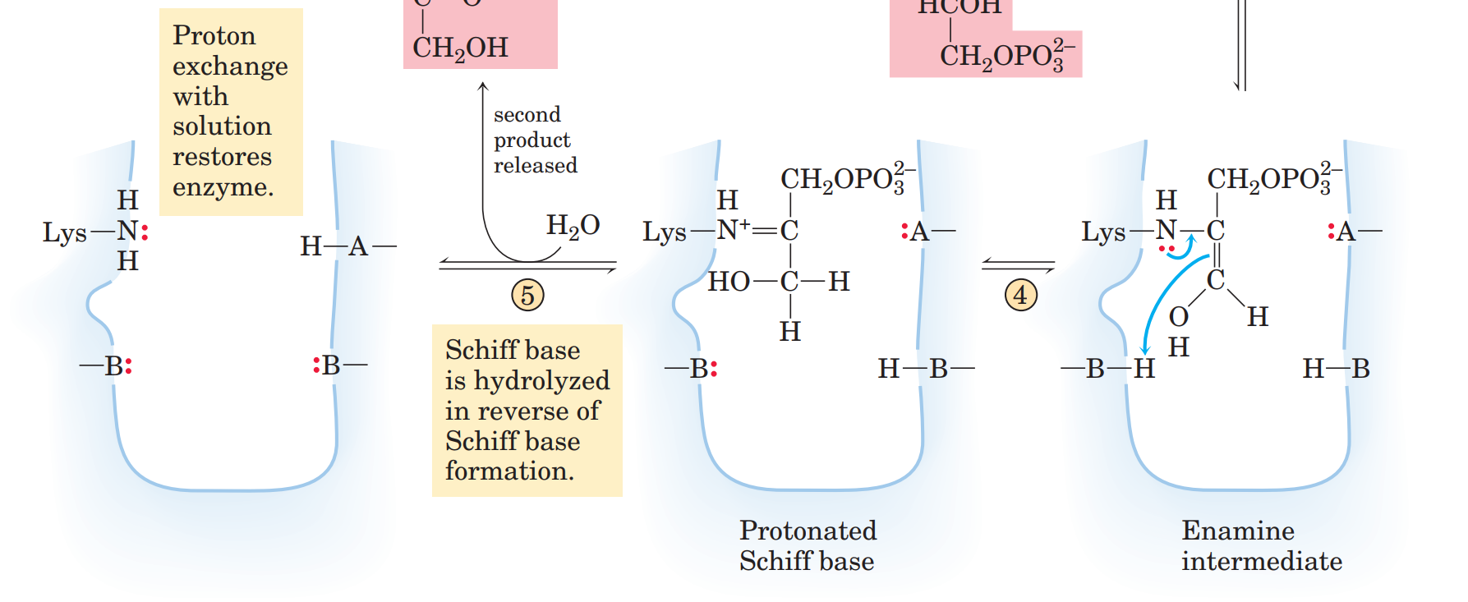
Reaction Four: The Mechanism
Arg
Chapter 14 page 528
Lehninger Principles in Biochemistry – 4th Edition (2005)

Slide 20
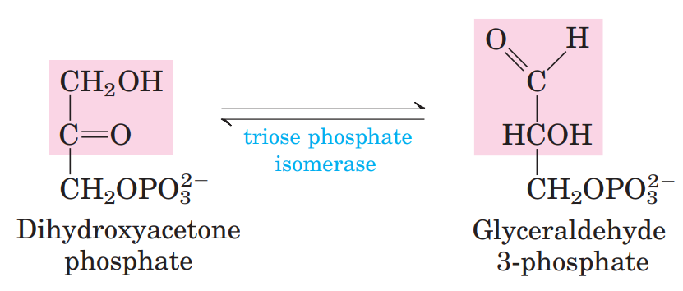
Reaction Five: Three Carbon Isomerization
Chapter 14 page 528
Lehninger Principles in Biochemistry – 4th Edition (2005)

Slide 21
Glycolysis: Setup and Payoff
Preparatory Phase of Glycolysis
Payoff Phase of Glycolysis
Image made in BioRender
Lehninger Principles in Biochemistry – 4th Edition (2005)

Slide 22
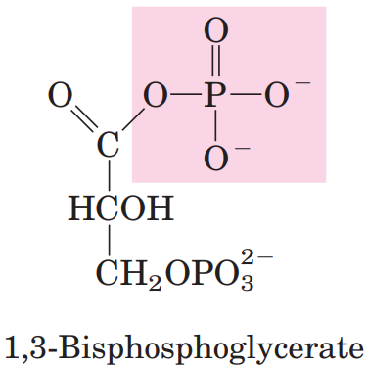
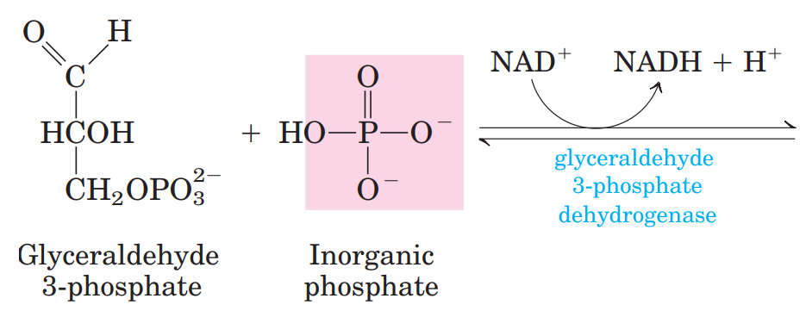
Reaction Six: Oxidation by Inorganic Phosphate
Chapter 14 page 528
Lehninger Principles in Biochemistry – 4th Edition (2005)

Slide 23
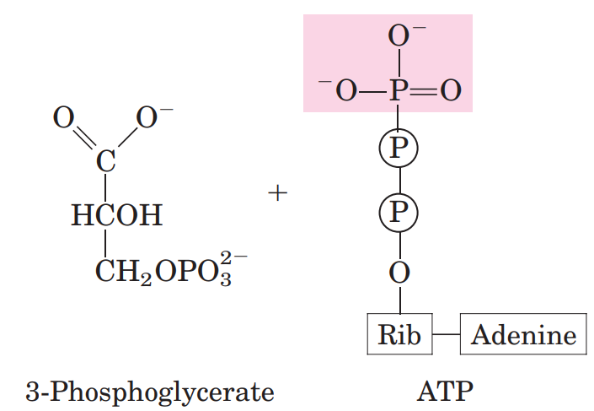
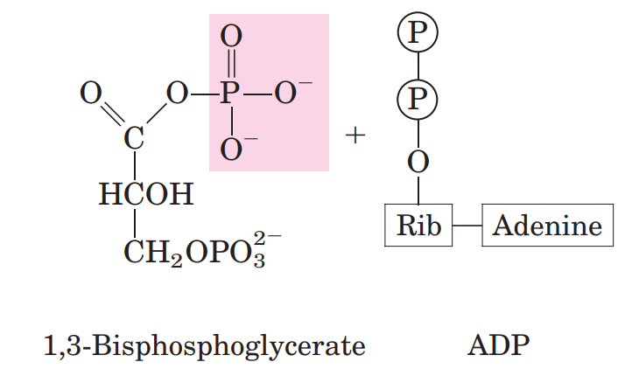

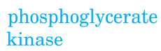
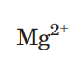
Reaction Seven: The First Payoff of ATP
Chapter 14 page 530
Lehninger Principles in Biochemistry – 4th Edition (2005)

Slide 24
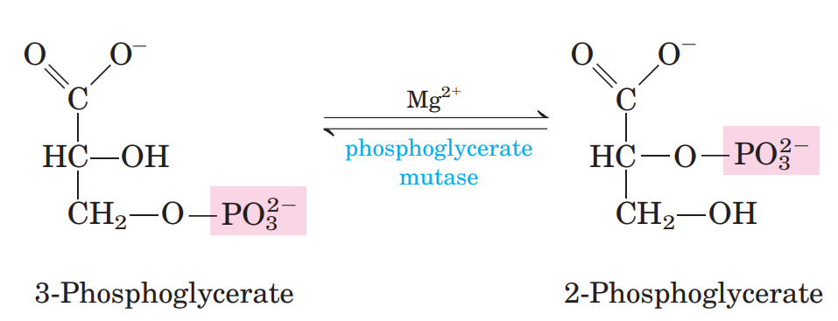
Reaction Eight: Mutase, ‘moving’ phosphates
Chapter 14 page 530
Lehninger Principles in Biochemistry – 4th Edition (2005)

Slide 25
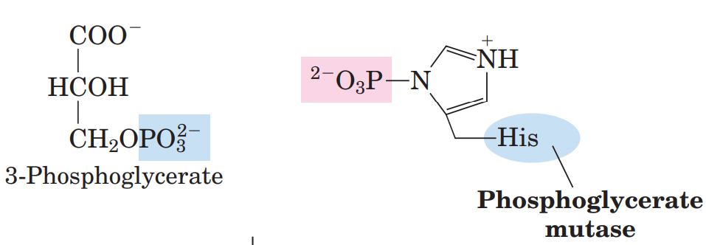
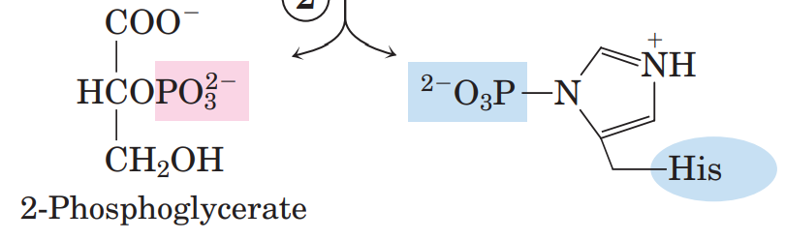
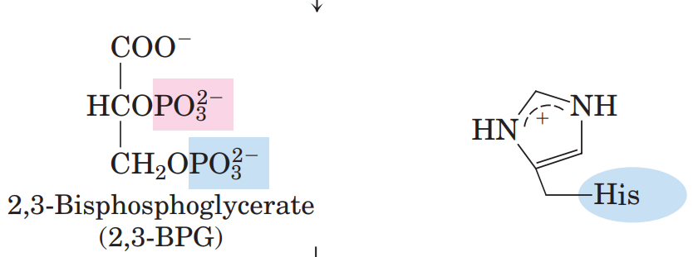
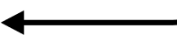
Reaction Eight: Phosphoglycerate Mutase Mechanism
Chapter 14 page 530
Lehninger Principles in Biochemistry – 4th Edition (2005)
Notes:
His residue
in most cells 2,3-BPG is present in only trace
amounts, it is a major component (~5 mM) of erythrocytes,
where it regulates the affinity of hemoglobin

Slide 26
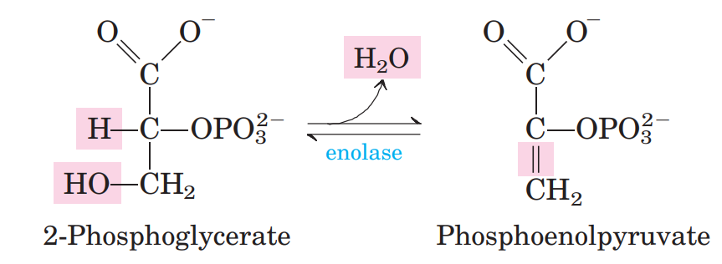
Reaction Nine: Enolase
Chapter 14 page 531
Lehninger Principles in Biochemistry – 4th Edition (2005)

Slide 27
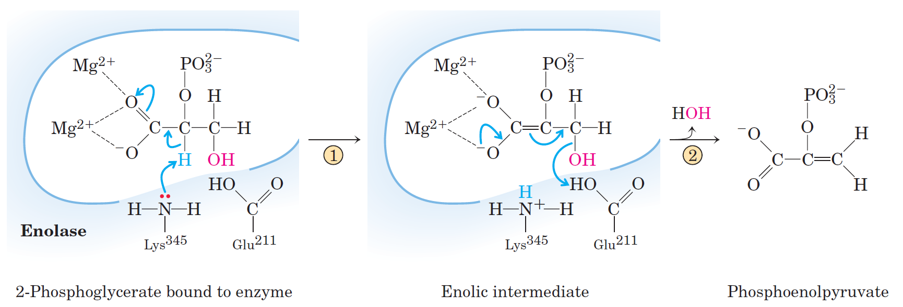
Reaction Nine: Enolase
Chapter 6 Page 216
Lehninger Principles in Biochemistry – 4th Edition (2005)

Slide 28
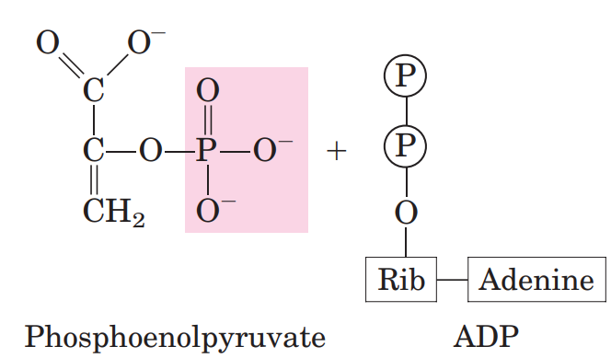
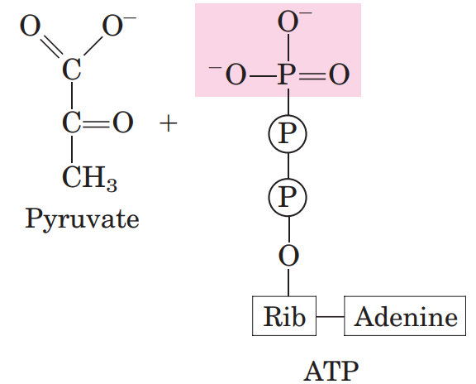
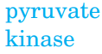
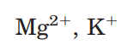
Reaction Ten: Pyruvate Kinase, the Second Payoff
Chapter 14 page 531
Lehninger Principles in Biochemistry – 4th Edition (2005)

Slide 29
Glucose Metabolism: Overview
Nearly universal.
Conserves energy as ATP (adenosine triphosphate) and NADH (nicotinamide adenine dinucleotide)
All ten steps involve phosphorylated compounds of six or three carbons.
Is highly regulated.
Image made in BioRender
Lehninger Principles in Biochemistry – 4th Edition (2005)
Notes:
Glycolysis is a near-universal pathway by which a glucose molecule is oxidized to two molecules of pyruvate, with energy conserved as ATP and NADH. ■ All ten glycolytic enzymes are in the cytosol, and all ten intermediates are phosphorylated compounds of three or six carbons. ■ In the preparatory phase of glycolysis, ATP is invested to convert glucose to fructose 1,6-bisphosphate. The bond between C-3 and C-4 is then broken to yield two molecules of triose phosphate. ■ In the payoff phase, each of the two molecules of glyceraldehyde 3-phosphate derived from glucose undergoes oxidation at C-1; the energy of this oxidation reaction is conserved in the formation of one NADH and two ATP per triose phosphate oxidized. The net equation for the overall process is
Glycolysis is tightly regulated in coordination with other energy-yielding pathways to assure a steady supply of ATP. Hexokinase, PFK-1, and pyruvate kinase are all subject to allosteric regulation that controls the flow of carbon through the pathway and maintains constant levels of metabolic intermediates

Slide 30
Learning Objectives:
Today We Will Learn How to:
Summarize the key steps in the glycolysis metabolic pathway
Recall the structural features, function, and general biochemical reaction of kinases
Recognize enzymes associated to this pathway
Articulate the mechanism of action of several enzymes in the glycolysis metabolic pathway

Slide 32
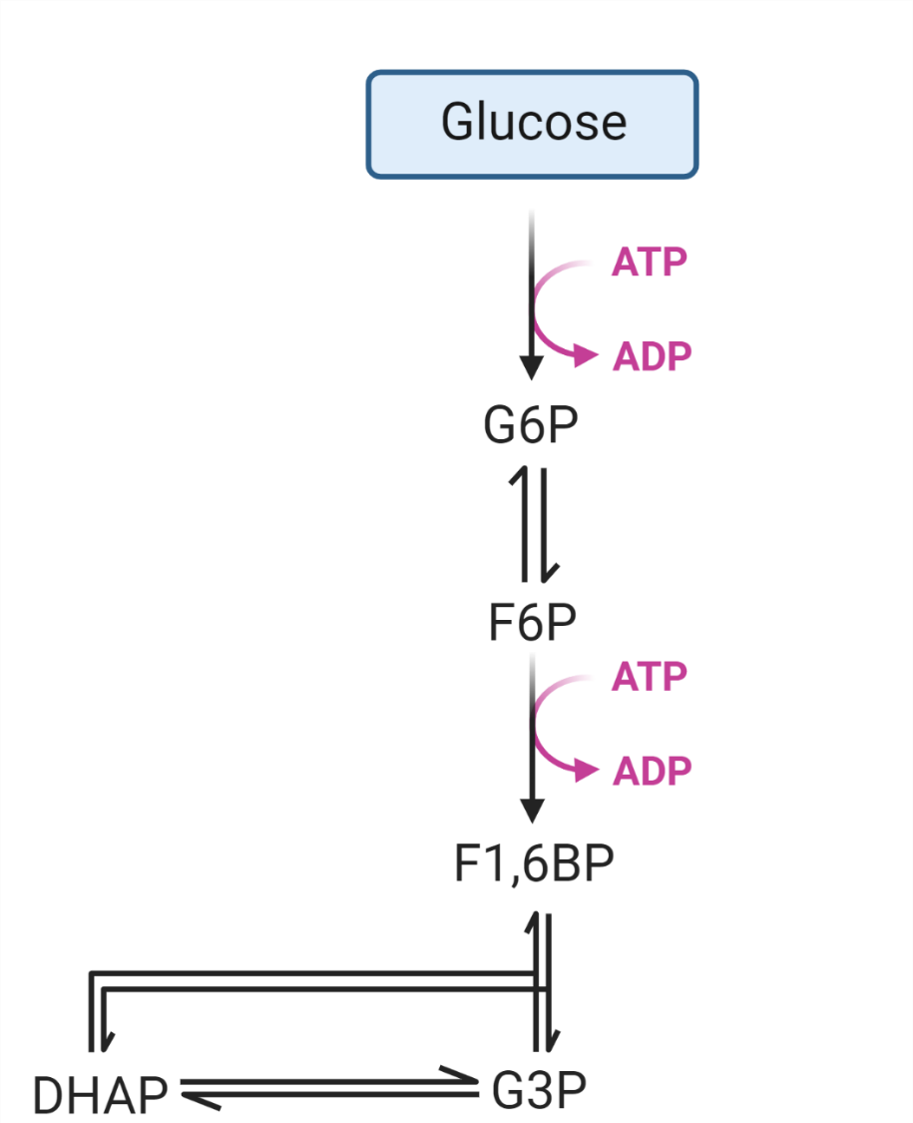
Glycolysis: Setup Overview
Image made in BioRender
Lehninger Principles in Biochemistry – 4th Edition (2005)

Slide 33

Payoff Phase of Glycolysis
Image made in BioRender
Lehninger Principles in Biochemistry – 4th Edition (2005)

